Slide 1
Nostalgia, Art, & the Archive
New England Archivists
Portsmouth, NH
Spring 2014
John Campopiano, Matt Spry, Dana Keller

Slide 2
Nostalgia in (a few) nutshells
Origins as a mental health issue
A “longing” for “place” or a period of time
A romantic feeling about displacement or loss

Slide 3
Restorative & Reflective Nostalgia
Restorative: re-construction of monuments and artifacts from the past
Reflective: longing for the past with the understanding that accurately recalling it is impossible; the past and memory as fragmentary and imprecise

Slide 4
Some nostalgic expressions today
Hauntological re-interpretations of historical image & sound
Networked and interactive dimensions of place
Colorization of history through digital means

Slide 5
Closing the loop
How do these different uses relate to our understanding of neutrality in the archives?
How do these different uses complicate traditional notions of copyright?
If at all, how might these uses be applied to collections in your own institutions?

Slide 6
Hauntology
Nostalgia, Art, & the Archive
New England Archivists
Portsmouth, NH
Spring 2014
John Campopiano

Slide 7
Hauntology: Examining an alternative heritage
Challenging temporality
Nostalgia & childhood
Reconsidering history & our sonic heritage

Slide 8
Hauntology: Tools for the job
Public information films / Government & state-issued announcements
Radio broadcasts
BBC Radiophonic Workshop (BBC Archives, BFI)
Library music
Home movies
Horror films and television programs
Media sharing spaces / Digital libraries (YouTube, Internet Archive)
Original instrumentation / composition

Slide 9
- Jim Jupp
“…In the music of each act you'll hear voices from sources such as archive folk recordings or government issued public information films, but they are often edited in a way to change their melodies or meanings.”

Slide 10
“Time’s arrow is now a circle.”

Slide 11
Hauntology: Examples
Artist: The Advisory Circle, album: Other Channels
“Civil Defense is Common Sense” (first 0:47)
“Frozen Ponds PIF” (0:52)

Slide 12
Collector Curator Creator

Slide 13
Opportunities & Challenges: For musician & archivist
Musician
Availability of resources
Over abundance = de-mystification in the digital age
Archivist (or information professional)
Ability to reach new users
Historical distortion (provenance)

Slide 14
“I think this kind of revisiting and re-presentation of archive material as a creative process in itself is a positive step, and ought also to inspire and encourage archivists to think more creatively about the possibilities inherent in their own collections and new ways to engage the public with what is usually hidden from their gaze.”
- Mark Pilkington, curator/musician/writer

Slide 15
Conclusion
What do YOU think? Concerns?
Issues to consider:
Legal implications / copyright
Historical distortion / the integrity of provenance
Access & use / content control

Slide 16
Interactive and
Networked Uses
Nostalgia, Art, & the Archives
Matt Spry
New England Archivists
Portsmouth, NH
Spring 2014

Slide 17
What do we mean by interactive/networked?
Interactive: the user provides some layer of input to a web-based platform (uploading, describing, etc.).
Networked: users sharing information across platforms (e.g. embed code, shares, retweets, likes, reblogs).

Slide 18
Geolocation History Platforms
Leverage Google Maps API against historical archival materials
Examples: Historypin, WhatWasThere, Sepiatown

Slide 19
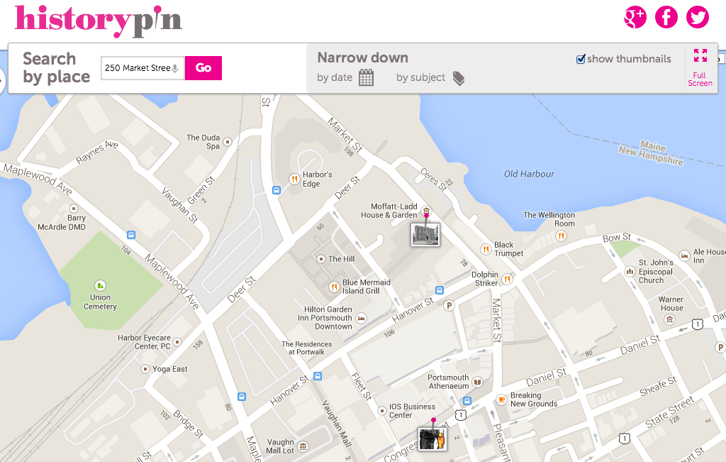
Historypin: Portsmouth, NH

Slide 20
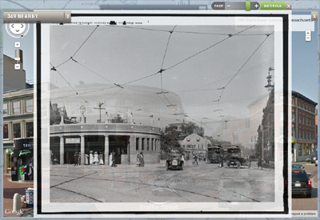
WhatWasThere: Harvard Square
Image Source: http://hdl.loc.gov/loc.pnp/det.4a24400
Entrance to subway, Harvard Square, Cambridge, Mass.
Detroit Publishing Company Photograph Collection
Library of Congress Prints and Photographs Division
Washington, D.C. 20540 USA
Notes:
Image Source: http://hdl.loc.gov/loc.pnp/det.4a24400
Entrance to subway, Harvard Square, Cambridge, Mass.
Detroit Publishing Company Photograph Collection
Library of Congress Prints and Photographs Division
Washington, D.C. 20540 USA

Slide 21
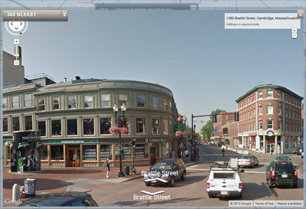
WhatWasThere: Harvard Square

Slide 22
Stereogranimator: Overview
Inspired by project by artist Joshua Heineman
Used the NYPL’s Digital Collection
Allows users to transform archival stereographs into web-shareable 3D images

Slide 23
Stereogranimator: Formats / GIFs
Source: http://stereo.nypl.org/view/40306
Notes:
Source: http://stereo.nypl.org/view/40306

Slide 24
Please Put on 3D Glasses

Slide 25
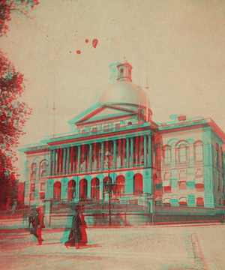
Stereogranimator: Formats / Anaglyphs
Source: http://stereo.nypl.org/view/44836
Notes:
Source: http://stereo.nypl.org/view/44836

Slide 26
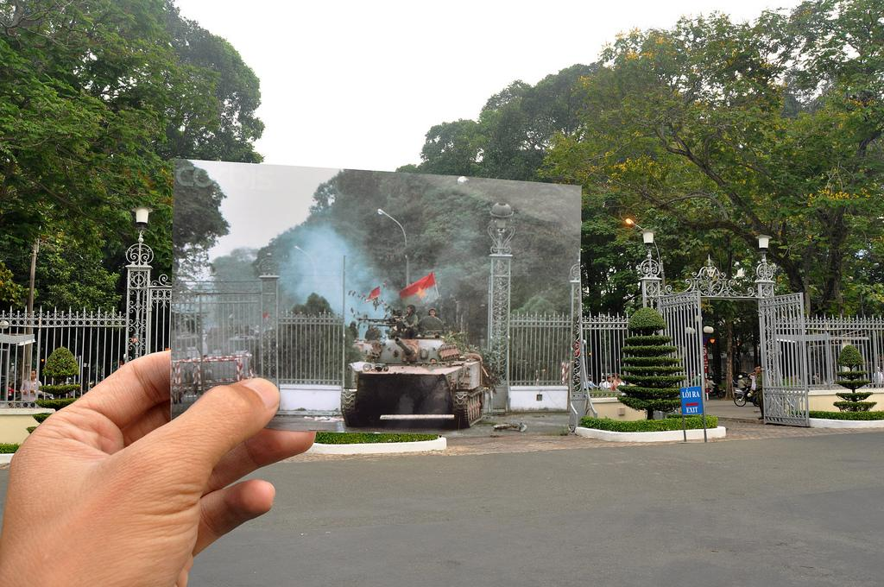
Artistic Photo Series: Khanh Hmoong
Source: Khanh Hmoong. https://www.flickr.com/photos/hmoong/6537668163/in/set-72157627891376819/
Notes:
Source: Khanh Hmoong. https://www.flickr.com/photos/hmoong/6537668163/in/set-72157627891376819/

Slide 27
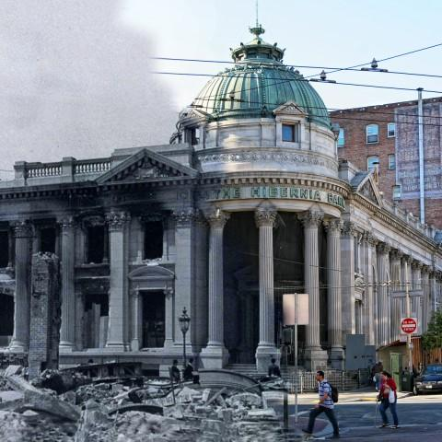
Artistic Photo Series: Shawn Clover
Source: Shawn Clover. http://d18d6t8kszgyle.cloudfront.net/wp-content/uploads/28-market-and-jones2-480x480.jpg
Notes:
Source: Shawn Clover. http://d18d6t8kszgyle.cloudfront.net/wp-content/uploads/28-market-and-jones2-480x480.jpg

Slide 28
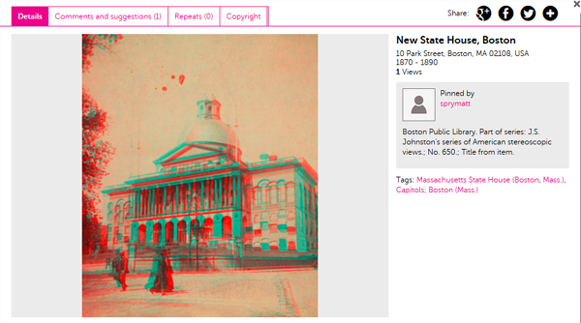
Possibilities: Stereogranimator on Historypin
Notes:
Source: http://stereo.nypl.org/view/44836

Slide 29
Possibilities: Photo Projects on WhatWasThere
Why combine them?
Only a certain amount of visual information is communicated by:
A street view of the present day. (e.g. Google Maps)
An artist’s photo (with or without the use of historical imagery)
A historical photo (no visibility into change over time).
Combining them in a single platform offers potential for a layered, networked meaning that contains the visual information offered
by all of them.

Slide 30
Counterbalance
"I think of my work less as nostalgia and more of an interrogation of history.
As an artist of color, I am always suspicious of a 'longing' for a past that was in many ways rife with terror and inequality.
At the same time I have an obsession with how nostalgia is used to selectively erase or omit a historical experience.
As an artist I am selecting and omitting as well—with the intent of shifting the viewer's relationship to the past and/or historical object in question.”
– Wayne Hodge, artist

Slide 31
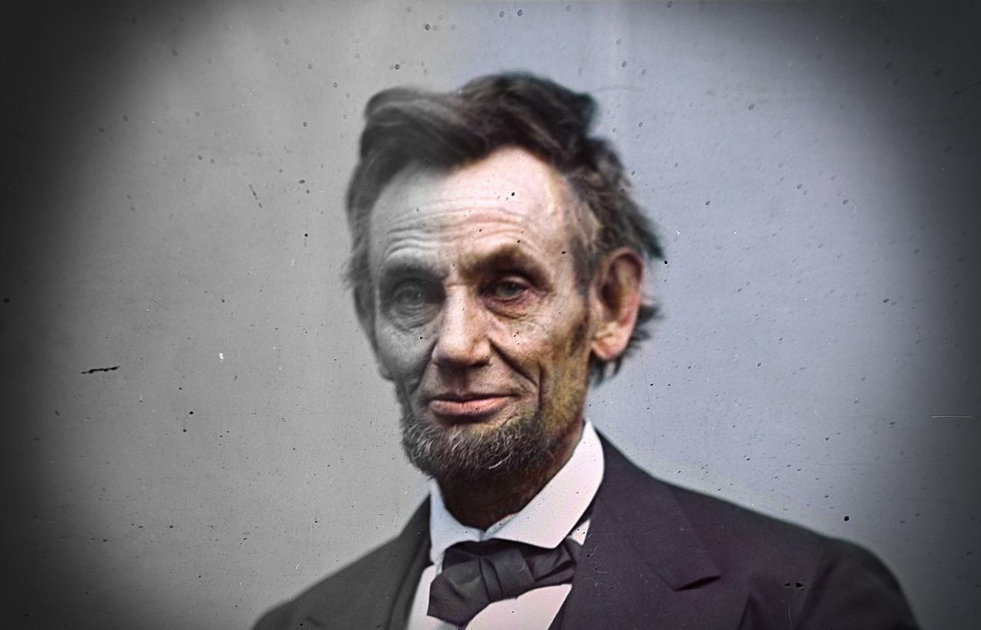
Colorizing History
Dana Keller
Nostalgia, Art & the Archives
New England Archivists
Portsmouth, NH
Spring 2014
Colored by Dana Keller | Original from LOC

Slide 32
“The Barrier”
Black and white photographs can seem like relics of the distant past.
We are “disconnected” from the world in which these photographs were taken.

Slide 33
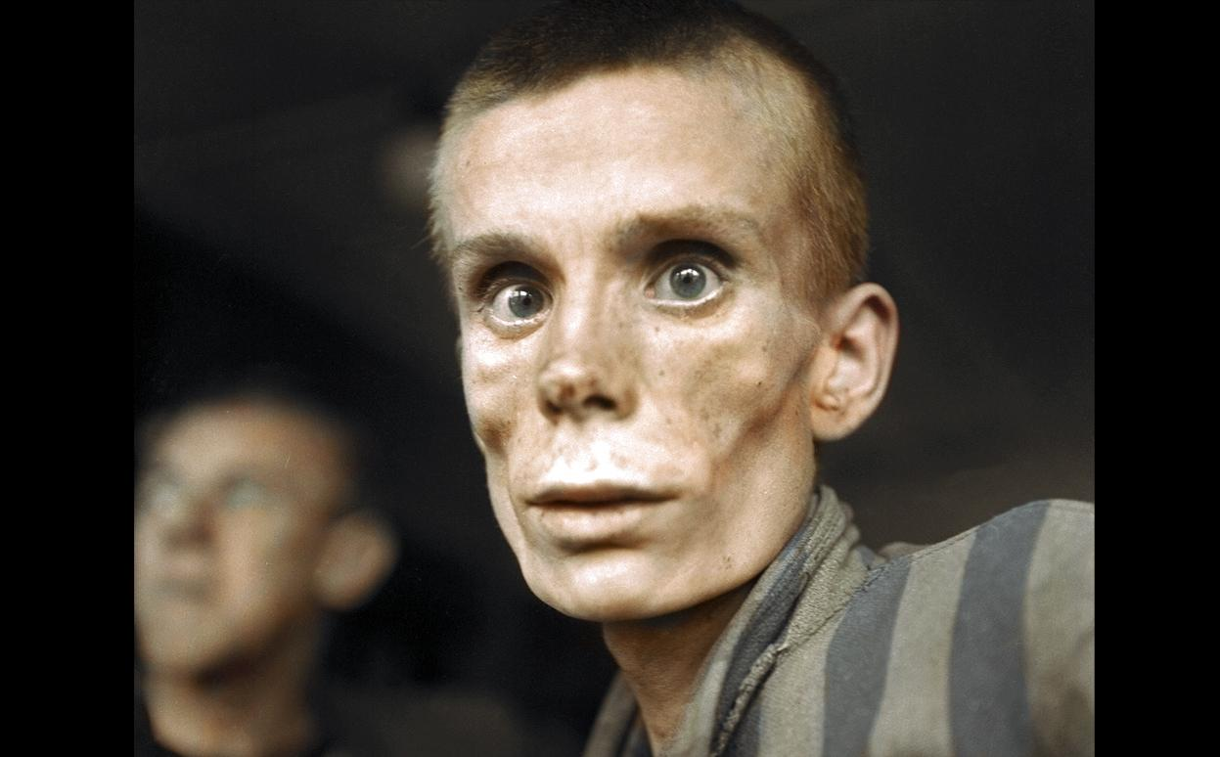
Why Colorize?
Colored by Dana Keller | Original from ERIC SCHWAB / AFP
“I have always seen this as just a cold bit of history...but now I feel its relevance.”

Slide 34
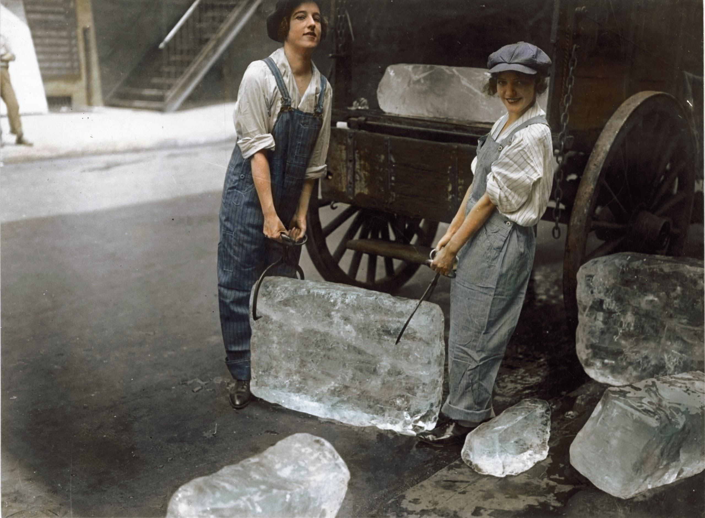
Why Colorize?
Colored by Dana Keller | Original from National Archives
“Of course I know they were real people, but now I realize that they lived.”

Slide 35
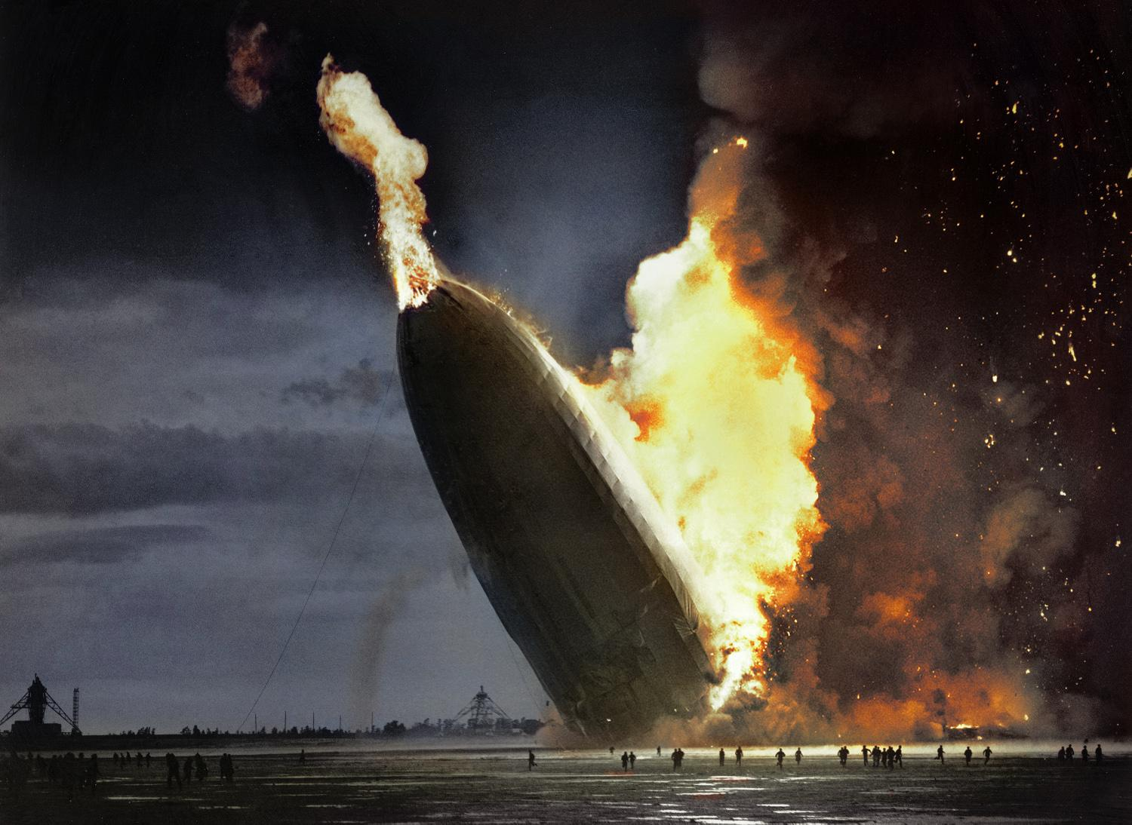
Why Colorize?
Colored by Dana Keller | Original from AP
“I have seen this image a hundred times, but suddenly it was real.”

Slide 36
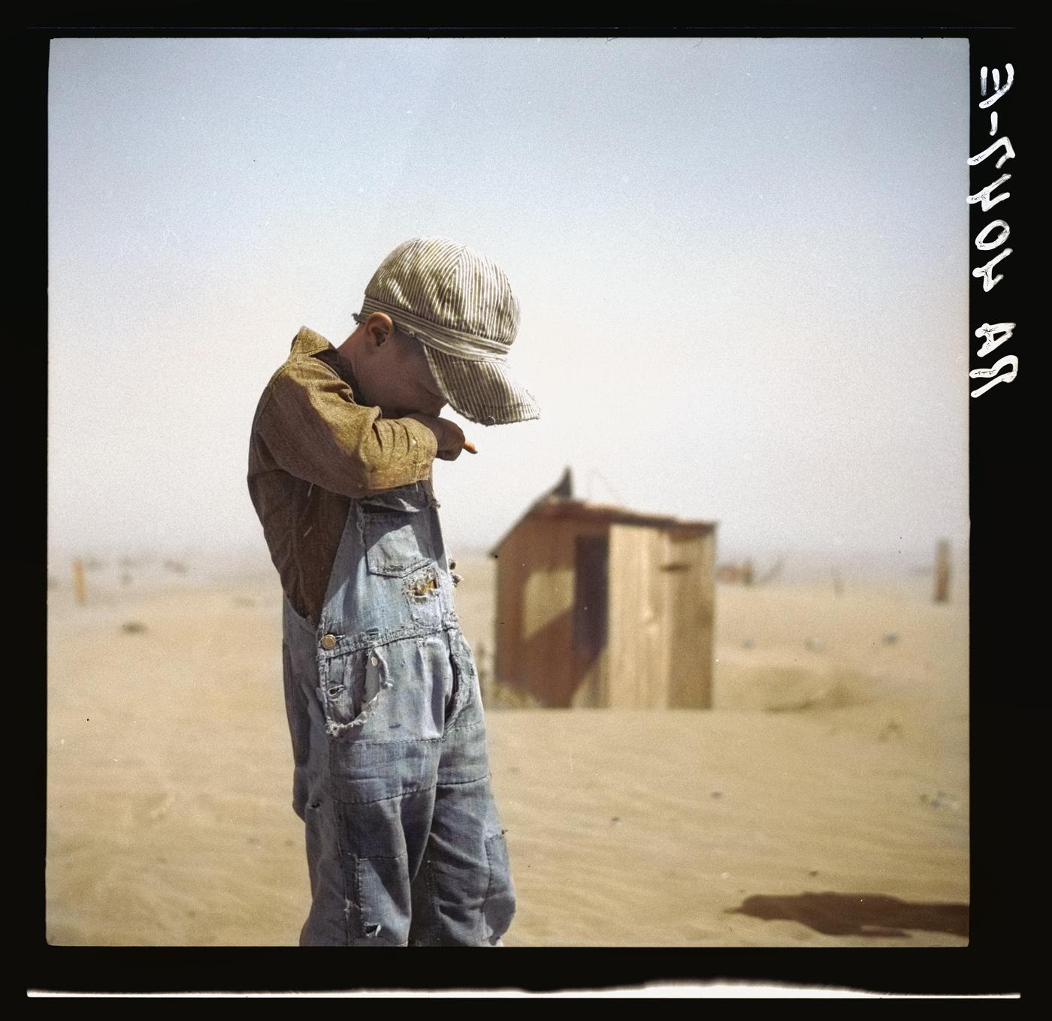
Why Colorize?
Colored by Dana Keller | Original from LOC
“These people...too easily seem like a relic of an unfathomable and distant age...”

Slide 37
Wait a minute.

Slide 38
What Colorization Is
It is NOT a replacement or “improvement” of original historical elements.
An opportunity to experience a closer connection to history.
A powerful tool to engage different communities.

Slide 39
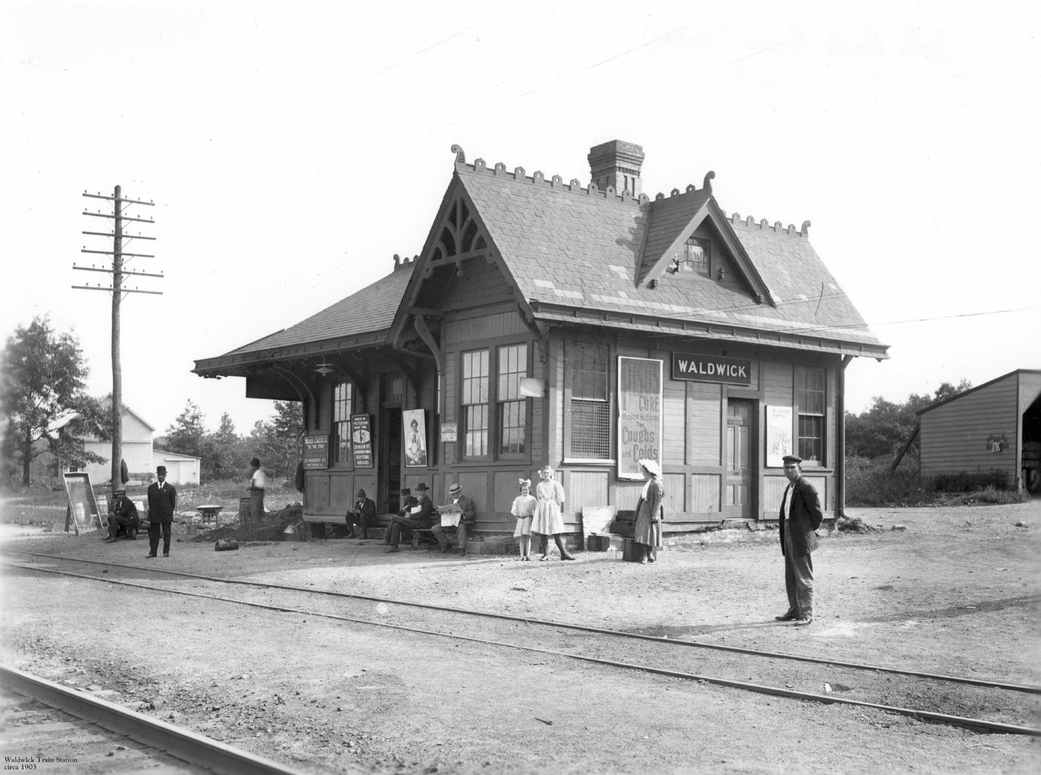
Example: Waldwick Train Station

Slide 40
Example: Waldwick Train Station

Slide 41
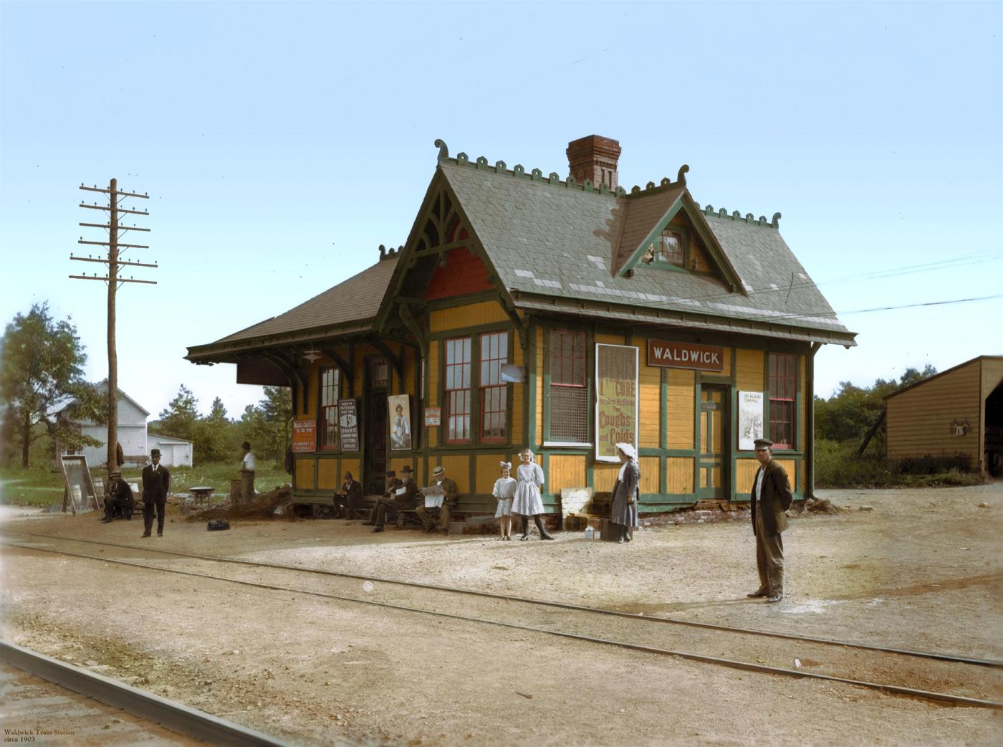
Example: Waldwick Train Station
Colored by Dana Keller | Original from City of Waldwick

Slide 42
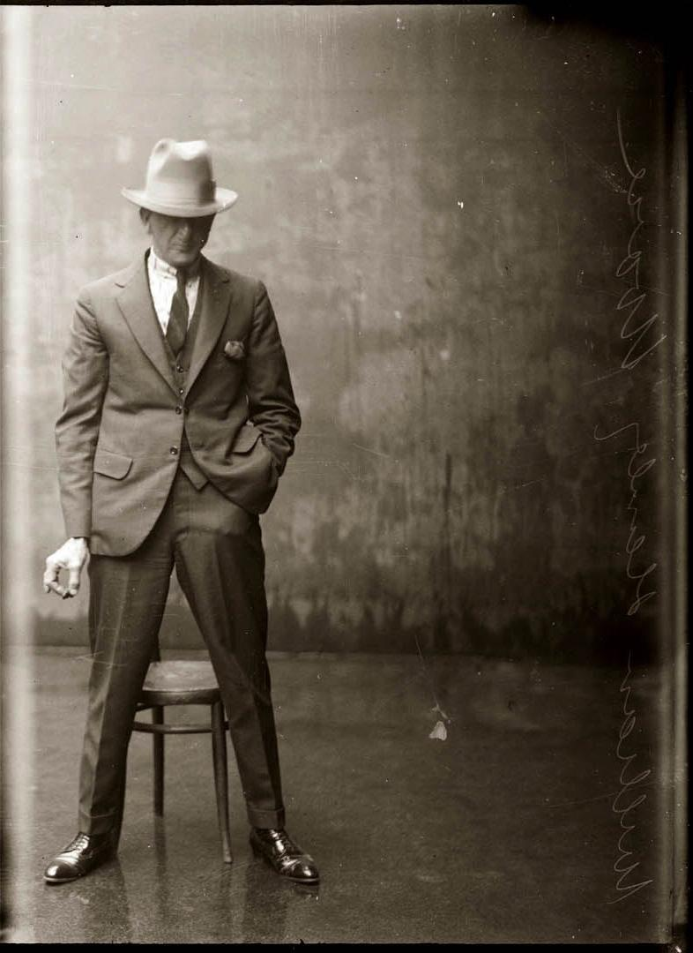
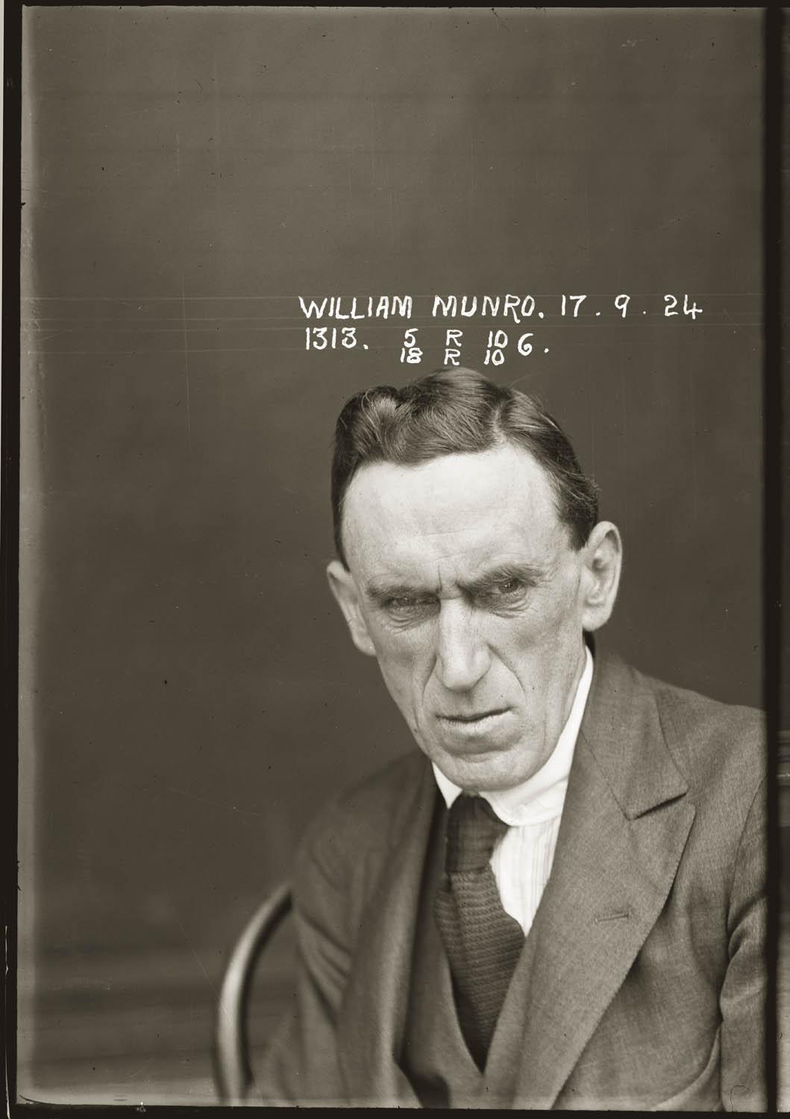
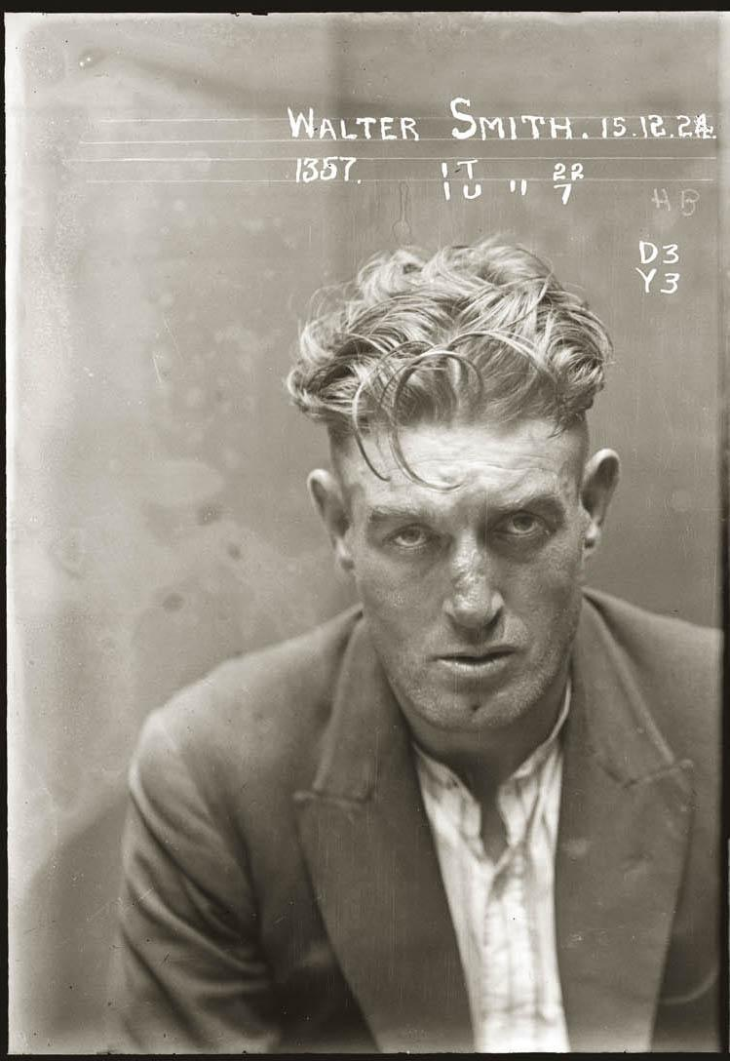
Engaging the Public
“Australian Mugshots” Collection

Slide 43
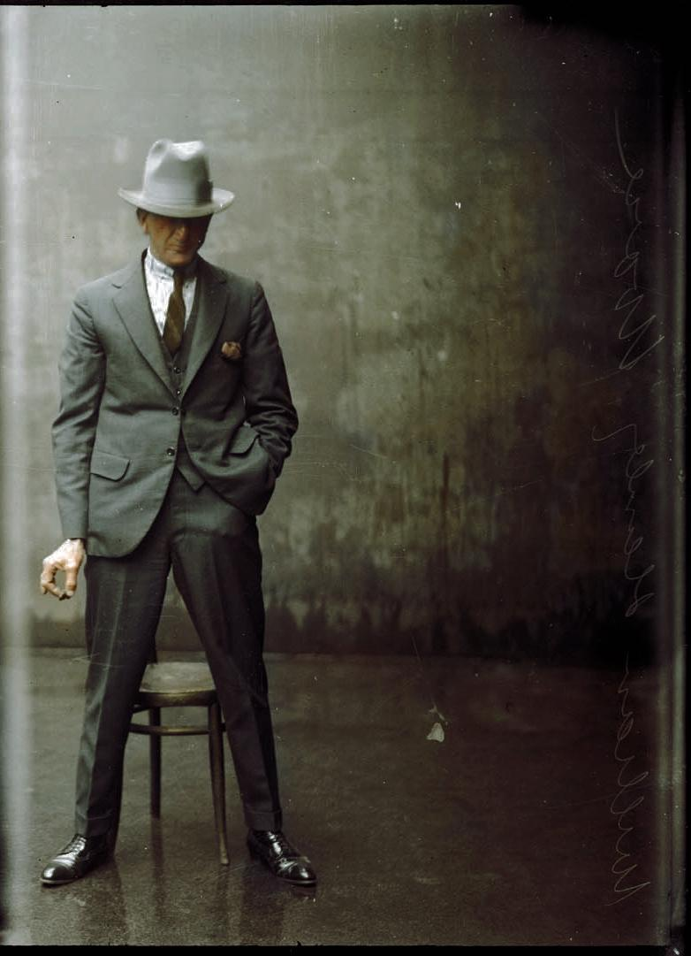
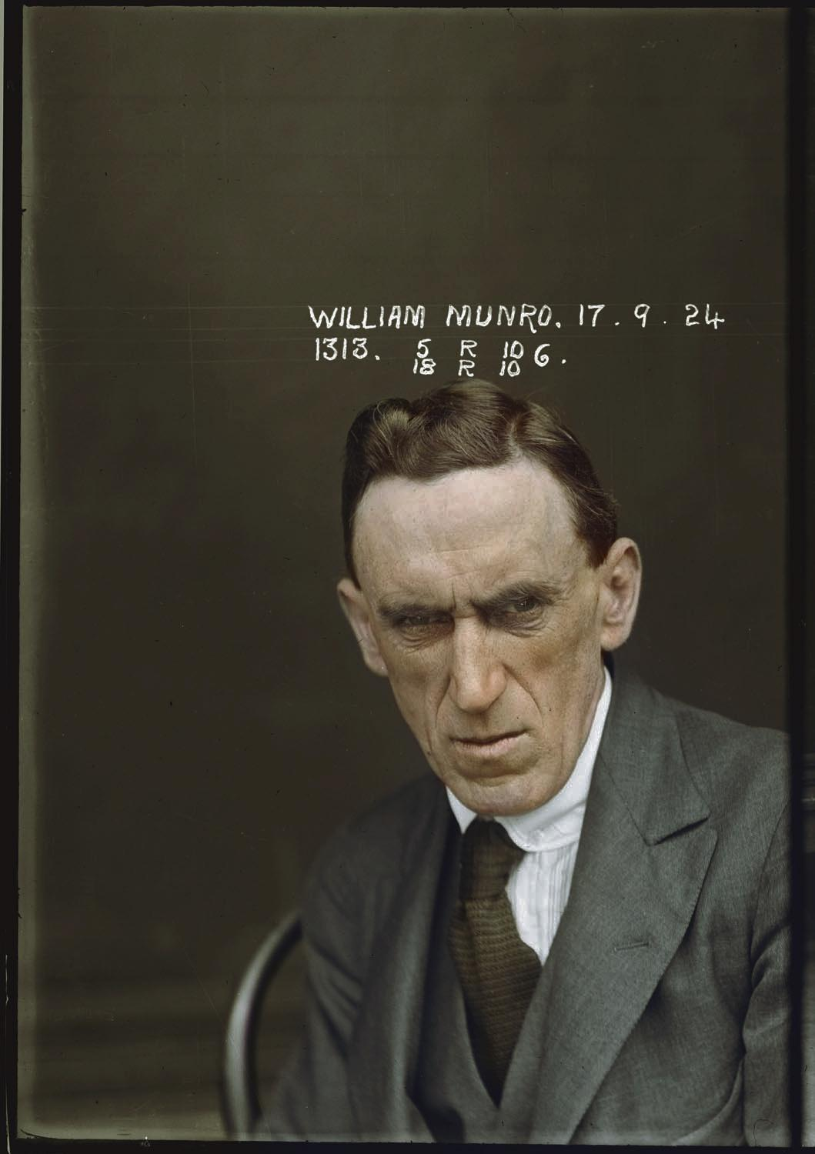
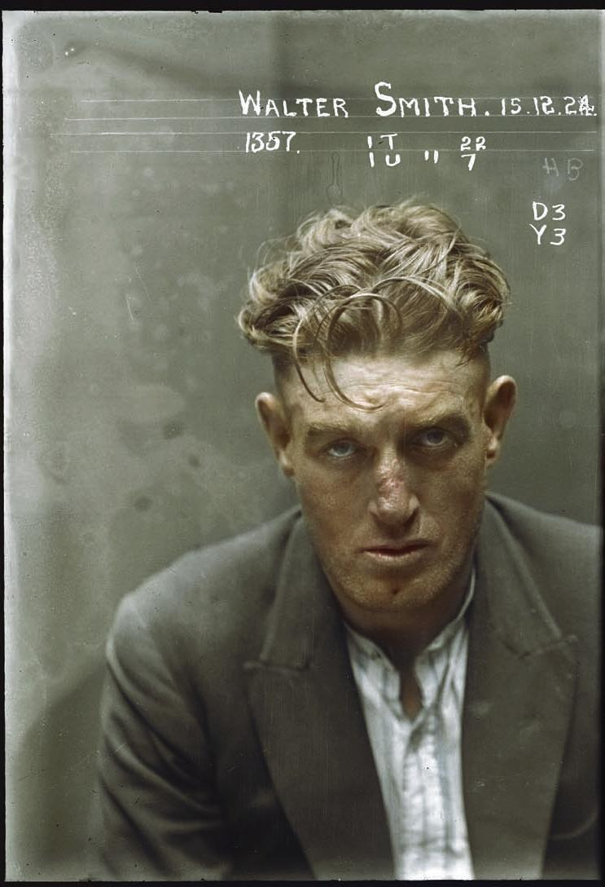
Engaging the Public
“Australian Mugshots” Collection
Colored by Dana Keller | Originals from Justice Police Museum / Historic Houses Trust

Slide 44
Conclusion
Thoughts
Questions
Concerns

Slide 45
Closing the loop
How do these different uses relate to our understanding of neutrality in the archives?
How do these different uses complicate traditional notions of copyright?
If at all, how might these uses be applied to collections in your own institutions?

